Slide 1
APHASIA
KB-74 APPLIED DATA SCIENCE

Slide 2
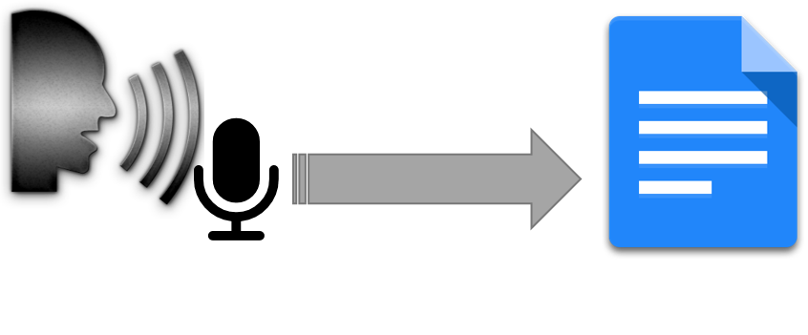
OBJECTIVE
Successful speech recognition
Identify mistakes
Notes:
For this project the first goal is to see if we can properly translate what Aphasia patients say to text and identify where they likely make mistakes in their language.

Slide 3


APHASIA
Language disorder
Speech impairment
Brain damage
Notes:
Aphasia is language disorder where patients have difficulty with reading, writing, understanding and speaking.
The aphasia is caused by non born brain damage, like stroke or caucusing.
The cases of aphasia where our patients are having are, light Aphasia patients with focus on not being able to speak, or understanding langue.

Slide 4

ASSIGNMENT
Rijndam rehabilitation Rotterdam
Ineke van der Meulen.
Notes:
The assignment is given at the Rijndam rehabilitation centrum in Rotterdam. The rehabilitation centrum is focused rehabilitating patients of all different kind of decides.
For this assignment we will be working with Ineke van der meulen.
Expert at the rehabilitation therapy of patients with Aphasia.

Slide 5

DATA
58 audio files
Speech exercises
Notes:
58 audio files of speech exercises with patients.

Slide 6
IDEAS
Interview
Translate the data into transcripts

Slide 7
PROBLEMS
No clear goal of the product owner.
No access to the data
Notes:
For this project the first goal is to see if we can properly translate what Aphasia patients say to text and identify where they likely make mistakes in their language.

